Slide 1

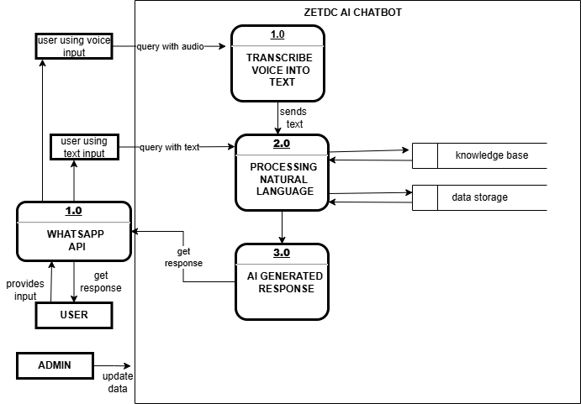
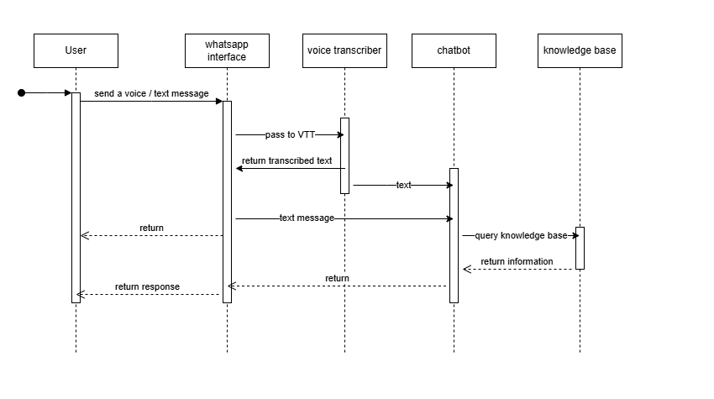
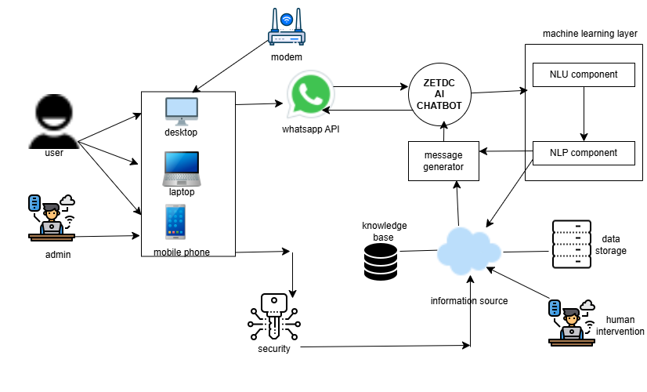
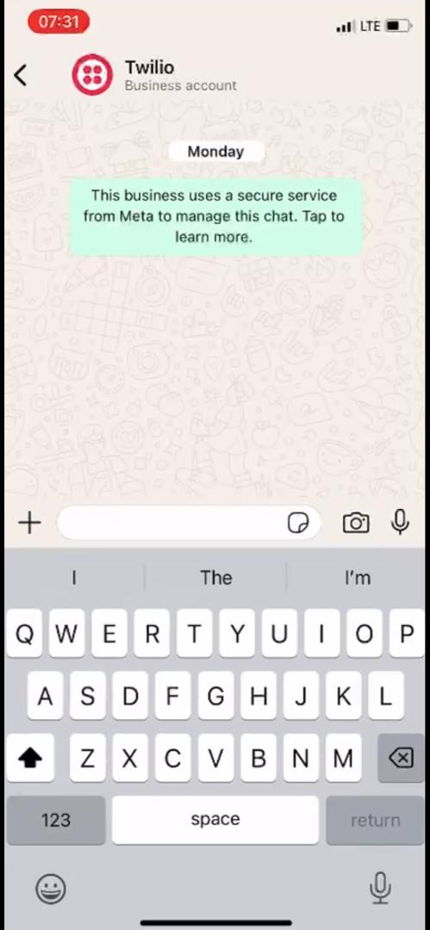
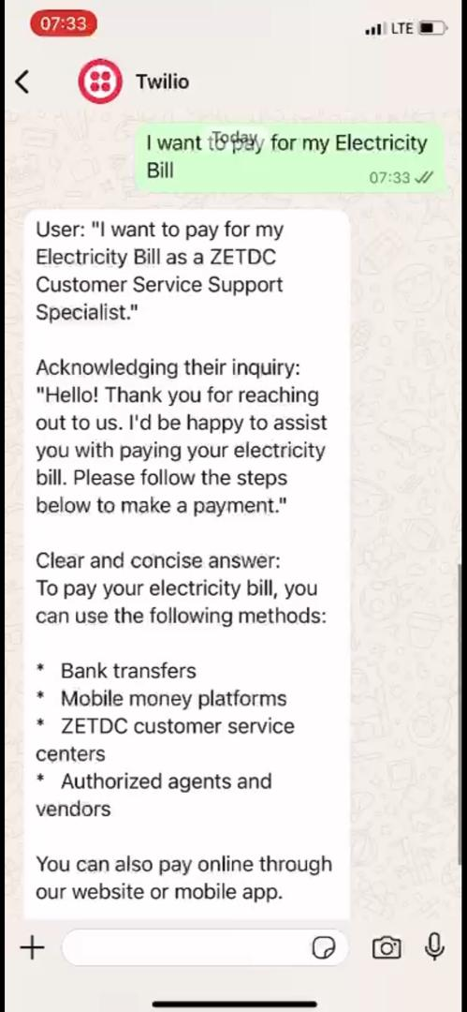
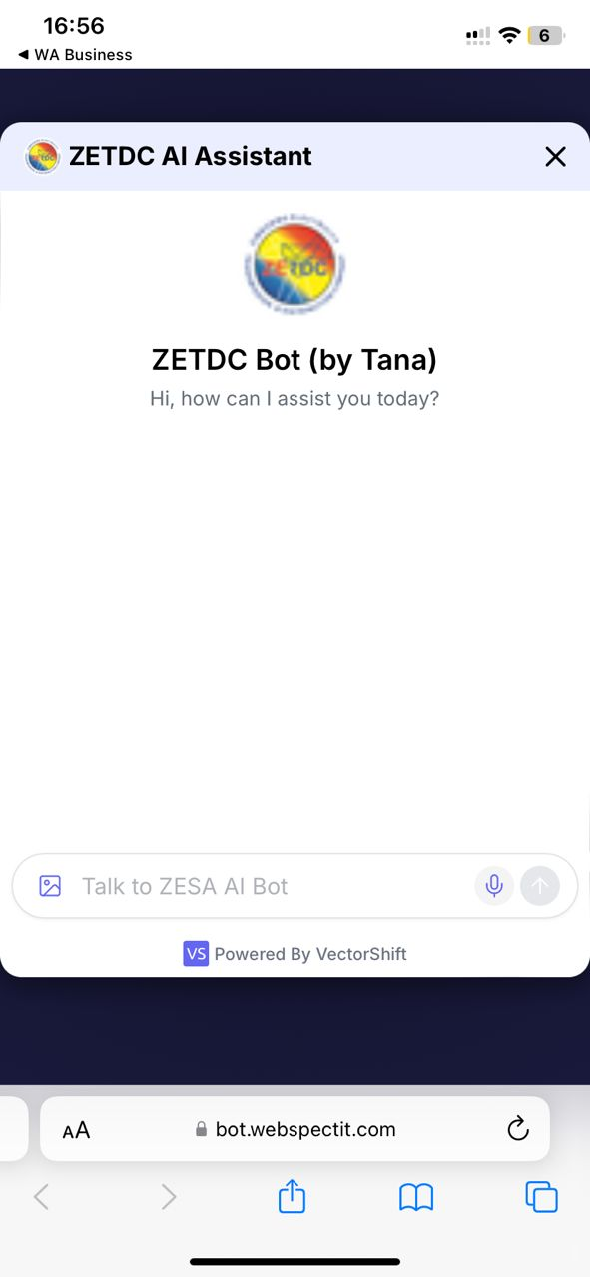
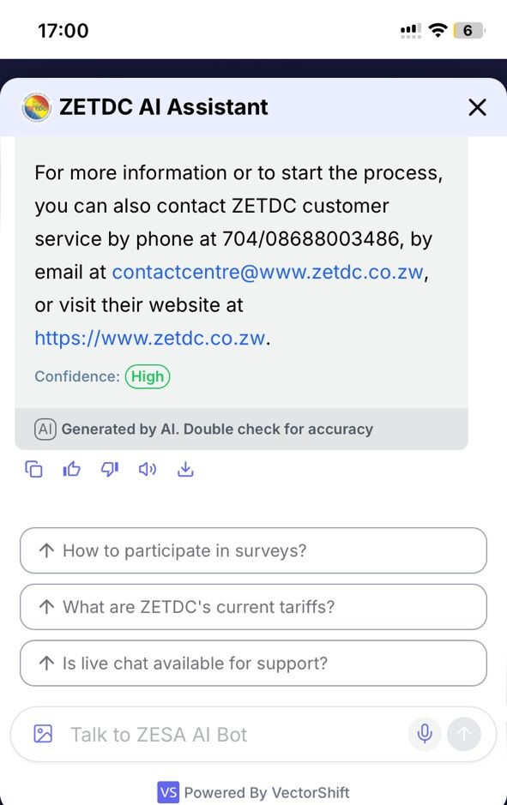
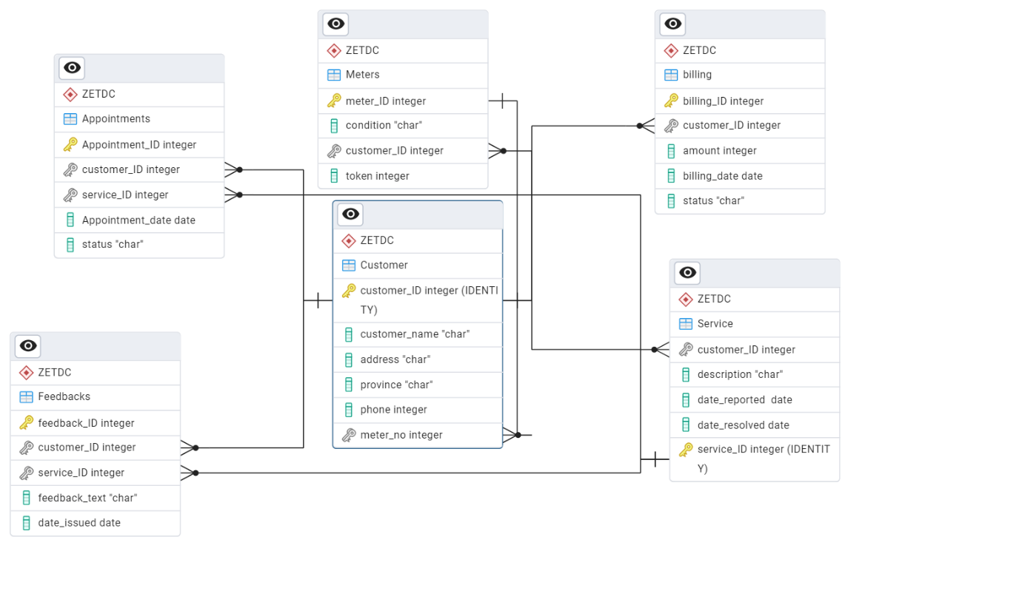
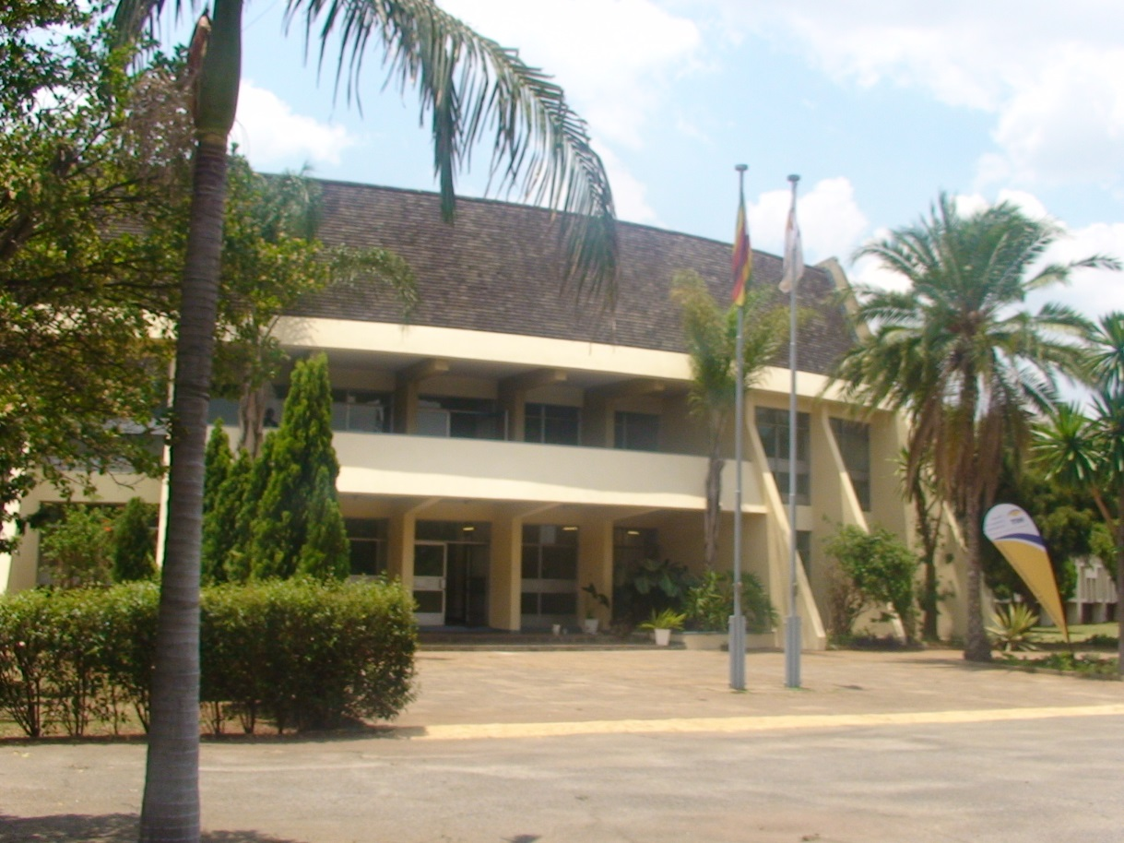
ZETDC AI POWER CHATBOT
^{1,2}Department of Information Security and assurance, School of information Sciences and Technology, Ganges Rd, Box BE 277,Belvedere,Harare,Zimbabwe
¹ Svetlana Maguze, ² Miss Y Chibaya
h210681w@hit.ac.zw,
²ychibaya@hit.ac.zw
Abstract
level 1 DFD
UML sequence Diagram
Conclusion
Over the last decade, communicating with customers through live chat interfaces has become an increasingly popular means to provide real-time customer service in many e-commerce settings and chat services have become the preferred option to obtain customer support [1]. However, most recently and fuelled by technological advances in artificial intelligence (AI), human chat service agents are frequently replaced by conversational software agents (CAs) such as chatbots, which are systems such as chatbots designed to communicate with human users by means of natural language [2]. chatbots, are systems designed to communicate with human users by means of natural language often based on artificial intelligence (AI). AI technologies and machine learning allow AI enabled chatbots to mimic human behaviour and enter conversational situations [3]. However, one important area in which CA/chatbots are used is the customer service activity, AI enabled chatbots are seen as a promising technology for service providers by providing automated customer service [3]. This paper presents the deployment of a WhatsApp based AI-powered voice and text chatbot designed to modernize customer support systems at the Zimbabwe Electricity Transmission and Distribution Company (ZETDC). The solution leverages natural language processing, and large language models to understand and respond to user intents via WhatsApp.
The implementation of the WhatsApp AI chatbot within ZETDC’s customer support infrastructure demonstrates the transformative potential of conversational AI in the utility sector. By leveraging voice recognition, natural language processing (NLP), and WhatsApp integration, the system effectively automated key services such as fault reporting and customer inquiries.
The results indicate substantial improvements in response times, operational efficiency, and customer satisfaction. The chatbot proved particularly valuable in handling high volumes of repetitive queries and fault reports, significantly reducing the burden on human agents and ensuring 24/7 service availability.
Moreover, the successful deployment of the multilingual voice interface marked a major step toward digital inclusion, enabling users across different regions and literacy levels to interact with the system naturally.
Overall, WhatsApp has shown that AI-driven conversational interfaces can play a critical role in modernizing customer engagement and service delivery in public utilities. With further enhancements and integration into backend systems, the solution is well-positioned to become a central pillar of ZETDC’s digital transformation strategy.
.
Future work
Introduction
Enhance Multilingual Capabilities
While English is currently supported, expanding to other regional languages will increase accessibility and inclusivity, particularly in rural communities.
Expand Use Cases Beyond Fault Reporting
Introduce additional services such as bill inquiries, meter top-ups, planned maintenance notifications, and tariff explanations to fully utilize the chatbot’s capabilities.
Implement Continuous Learning and Feedback Loop
Introduce a mechanism where the chatbot learns from customer corrections and feedback, improving its intent classification and response accuracy over time.
Include Escalation to Human Agents with Context
When a human agent takeover is required, the system should pass conversation history and extracted context to avoid repetition and reduce handover friction.
The Zimbabwe Electricity Transmission and Distribution Company (ZETDC), a subsidiary of ZESA Holdings, is responsible for electricity distribution and retail across Zimbabwe. As a public utility, ZETDC receives thousands of customer inquiries daily, ranging from billing complaints to power outage reports. Chatbots can prove to be an interesting solution here, since it Increase customer service quality, Customer service staff can lose enthusiasm when they spend excessive time answering repetitive queries [4]. By employing chatbots to handle routine questions and passing them over when more insight is needed [4], making their efforts more rewarding. Increase audience engagement capacity, Chatbots operate without the time and energy restrictions of humans, enabling them to answer questions from customers worldwide at any time [4].
Maintain consistent communication, Chatbots provide consistent information and messages, helping to ensure that every customer receives the same level of service. This consistency, derived from the knowledge base, helps to maintain brand integrity and accuracy in customer communications [4]. Maintain composure
Anyone can have a bad day, which might cause customer service agents to react in ways they might later regret. Also, customer service calls often begin with customers venting their frustrations from a prior experience [4]. This enables the composed customer service chatbot to absorb most of the frustration [4].
Architectural Design-hardware
Results and screenshots
References
[1] M. W. M. &. B. A. Adam, "AI-based chatbots in customer service and their effects on user compliance," Electron Markets, vol. 31, p. 425, 2021.
[2] U. M. S. &. M. A. Gnewuch, "Towards designing cooperative and social conversational agents for customer service," Proceedings of the 38th International Conference on Information Systems (ICIS), 2017.
[3] A. Følstad and P. Brandtzaeg, " Users’ experience with chatbots," Findings from a questionnaire study, vol. 3, p. 5, 2020.
[4] J. Holdsworth, "Unlocking the power of chatbots: Key benefits for businesses and customers," IBM, 18 january 2024. [Online].
Problem Statement
Screenshots for the whatsApp Interface
The Zimbabwe Electricity Transmission and Distribution Company (ZETDC) is facing significant challenges in delivering efficient customer service due to increasing electricity demand and evolving customer expectations. Key issues include inconsistent information provided by human agents, which arises from varying levels of knowledge and experience, as well as the high operational costs associated with maintaining a large customer service team. Additionally, the management of customer data and interactions is overwhelming, leading to missed opportunities for personalized service. These challenges hinder ZETDC's ability to meet customer needs effectively. Therefore, there is a pressing need to implement a voice-powered chatbot solution that can streamline customer interactions, provide consistent and accurate information, and enhance overall service efficiency. This innovative approach aims to improve customer satisfaction while simultaneously reducing operational costs, positioning ZETDC as a leader in modern customer service within the energy sector.
Database Design
Objectives
2025
To create a WhatsApp-based platform featuring an interactive voice chatbot for notifications and inquiries with standardized responses, ensuring consistency in the information provided to customers.
To handle several inquiries simultaneously, providing immediate responses and reducing the load on human agents and allowing customers to receive assistance anytime, improving customer satisfaction.
To collect and analyze customer data during interactions, providing insights that help tailor future communications and improve service.
Harare Institute of Technology
P. O. Box BE 277, Belvedere, Harare
Zimbabwe
Web interface of the chatbot
\jj

